Slide 1
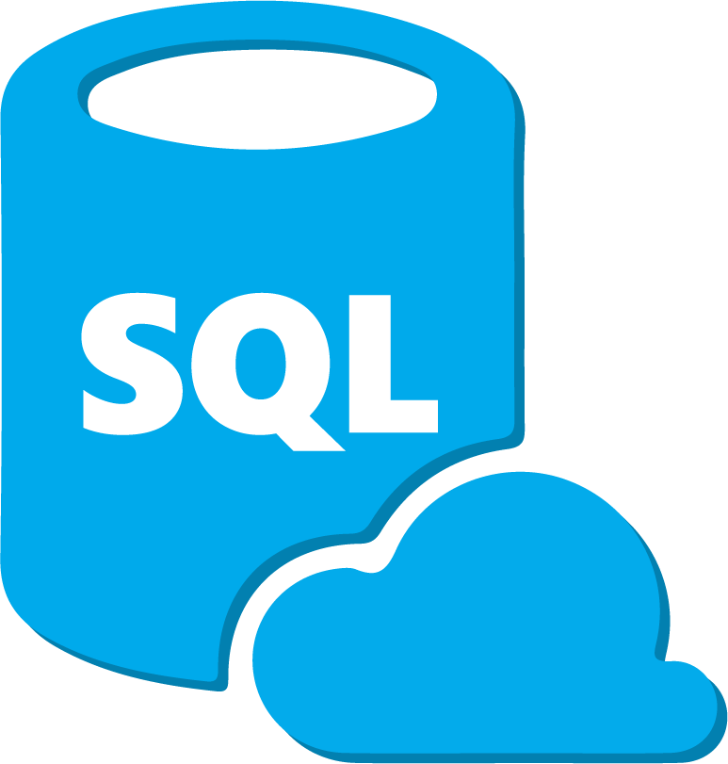

SHOE SALES MANAGEMENT SYSTEM
_{IP}
XII-A
Presentation by Shivendra Singh
1

Slide 2
TABLE OF CONTENT
Introduction
How does it Work?
Overview
Output
Future Scope
Regards
2

Slide 3
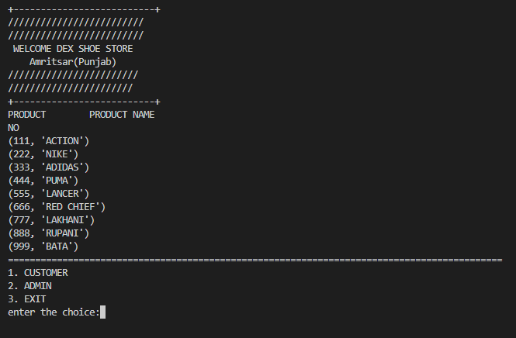
INTRODUCTION
Sales Management System is a very useful software used for various purposes of the shopkeepers.
It can be modified according to the needs of the owner .
It serves the widespread scopes in making the work maintain the record easier.
Its is not only useful for owner , but it is also useful for the customer in the way of handling it.
3

Slide 4
HOW DOES IT WORK
It works on the basic principle of the linking python and a SQL database .
At first , the command will be given in python software afterwards the command will be sent to the database.
There in the database the command will fetch the demanded data and it will pass it to the python software.
Then the required output will be shown to the python software.
4

Slide 5
PYTHON
Python is a high-level, general-purpose programming language. Its design philosophy emphasizes code readability with the use of significant indentation.
Python consistently ranks as one of the most popular programming languages.
Guido van Rossum began working on Python in the late 1980s as a successor to the ABC programming language and first released it in 1991 as Python 0.9.0
4

Slide 6
MySQL
MySQL is an open-source relational database management system (RDBMS).
A relational database organizes data into one or more data tables in which data may be related to each other; these relations help structure the data.
SQL is a language programmers use to create, modify and extract data from the relational database, as well as control user access to the database
4

Slide 7
SHOE SALES MANAGEMENT SOFTWARE
MySQL
PYTHON
TABLE
COLUMNS
NUMPY
MATPLOTLIB
LOOPS
CSV
INPUT
5

Slide 8
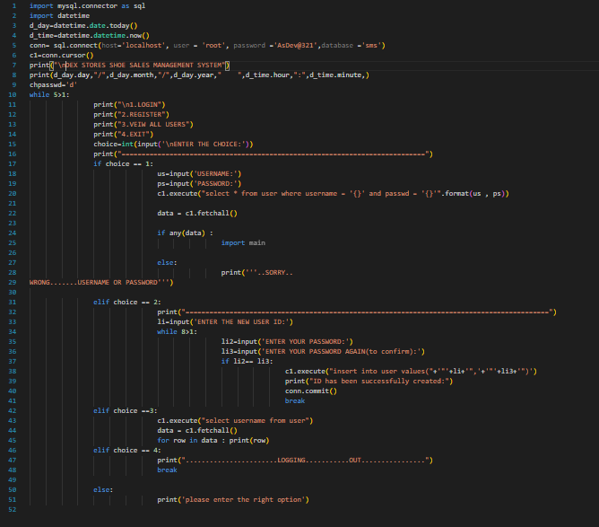
SOURCE CODE:(shoesalesmanagement.py)
5

Slide 9
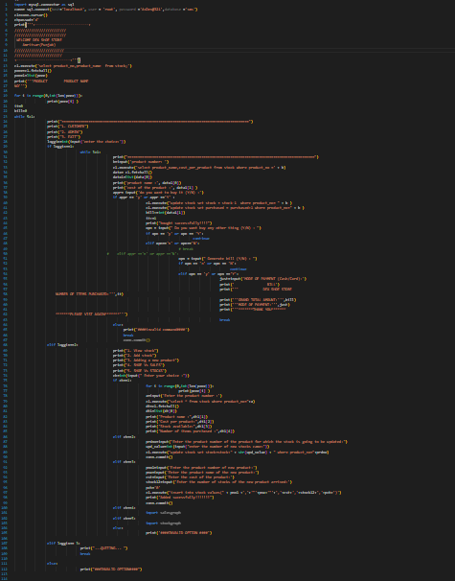
SOURCE CODE:(main.py)
7

Slide 10
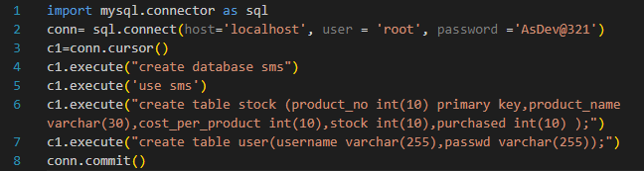
Creating table For DATABASE
8

Slide 11
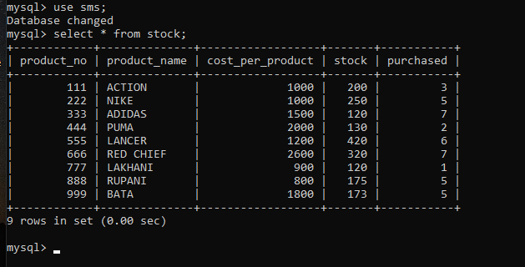
SQL DATABASE
9

Slide 12

OUTPUT
10

Slide 13
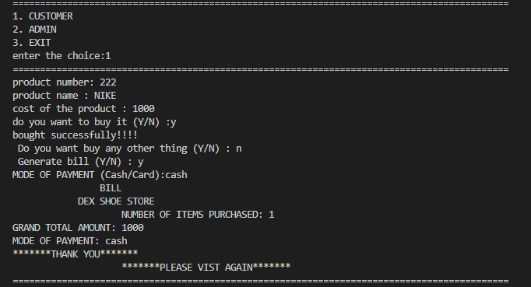
OUTPUT
11

Slide 14
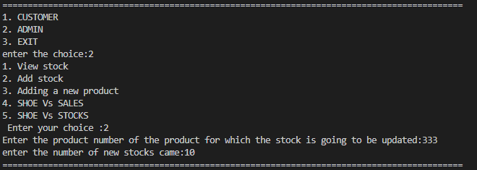
OUTPUT
12

Slide 15
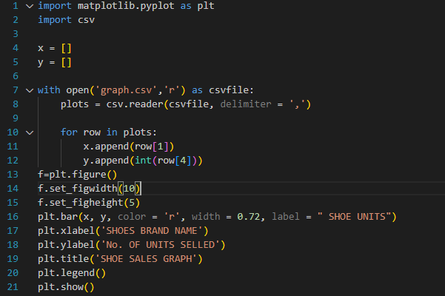
SALES GRAPH : MATPLOTLIB
13

Slide 16
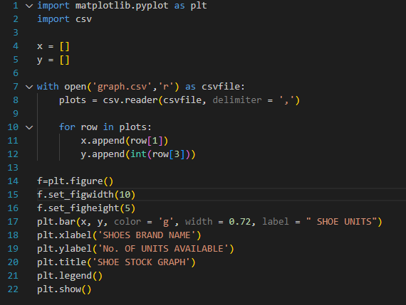
STOCKS GRAPH : MATPLOTLIB
14

Slide 17
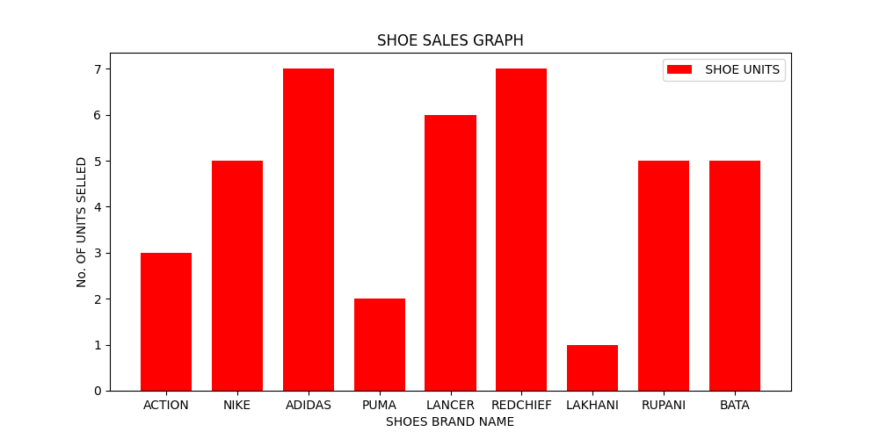
OUTPUT:GRAPH
15

Slide 18
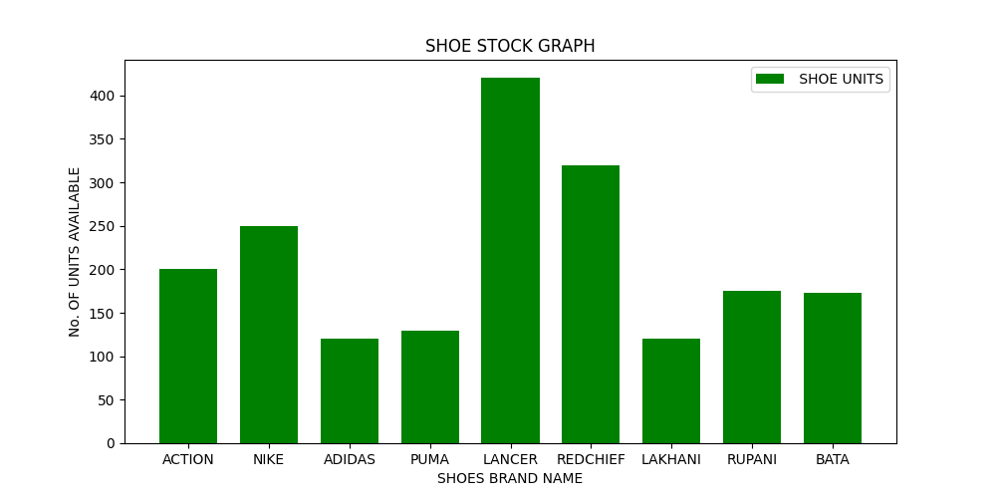
OUTPUT:GRAPH
16

Slide 19
FUTURE SCOPE
In future this software will be there in a high demand as the every thing is getting advanced.
If this software is developed with help of a big database like oracle , the software’s demand will further increase.
As this software is very cheap, its affordability will be more.
17

Slide 20

Any Questions?
Presentation by:
Shivendra Singh
REGARDS

